Slide 1
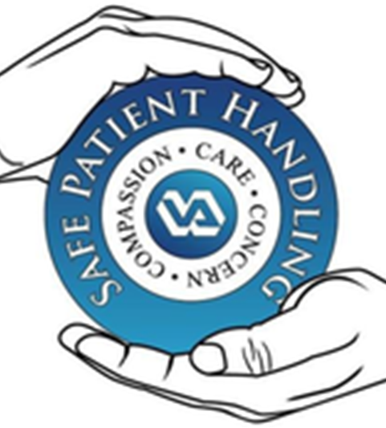
SPHM (Safe Patient Handling & Mobility)
Directive, concepts & policies
Presented by: Reggie Diaz Lamborn BSN, RN, CSPHA
SPHM program manager
Va central California health care SYSTEM

Slide 2
National Directive 1611 establishes Safe Patient Handling and Mobility as a Veterans Administration Priority.
Medical Center Policy 118-21-013 establishes the Safe Patient Handling and Mobility policy for the VACCHS.
Safe Patient Handling and Mobility is of nationwide importance.
Notes:
PLAY ANA video!

Slide 3
VHA Directive
1. POLICY
It is Veterans Health Administration (VHA) policy that a Safe Patient Handling and Mobility (SPHM) program be implemented in every Department of Veterans Affairs (VA) medical facility and that SPHM technology be incorporated as appropriate in the planning, design and construction of new construction and renovation projects, to protect VHA health care workers and Veterans from injuries due to patient handling and mobility, ensure that all Veterans have equitable opportunity to access SPHM technology, as needed, and to meet and improve Veteran care needs. Employees must utilize SPHM technology for routine and urgent patient handling tasks that require lifting over 35 pounds of patient weight or when performing tasks that require the generation of excessive force, such as repositioning a Veteran in a bed by pushing, pulling or supporting a Veteran during mobility. In addition, all design projects in spaces used by Veterans must include VA medical facility SPHM Program Manager (PM) input.

Slide 4
The Purpose of the SPHM program
1. To reduce the risk of work-related injury as it relates to patient handling and mobility tasks.
2. To reduce the risk of patient injury as it relates to patient handling and mobility tasks.
Notes:
Healthcare workers are at a very high-risk level for injury and, according to OSHA, manual handling of patients is the primary driver.
In 2017, nursing assistants were second only to laborers and freight, stock and material movers in the number of musculoskeletal cases.

Slide 5
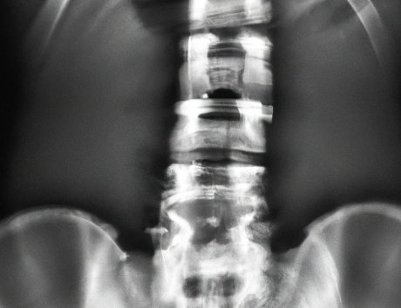
THE COST TO HEALTH CARE PROVIDERS
52% OF NURSES COMPLAIN OF LOW BACK PAIN and 83% of them continue to work despite that pain.
Lifting injuries are the #1 cause of lost workdays for CNAs and other Health Tech professions nationwide.
According to the ANA, musculoskeletal injuries affect 38% of all nurses and CNAs. This results in light duty status, absences, and/or long-term disability.

Slide 6
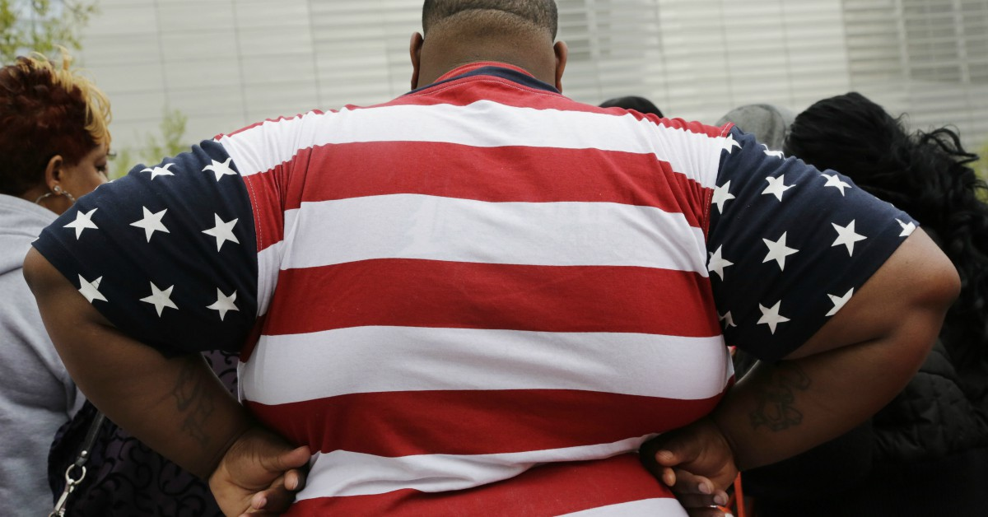
Bariatric Patient Handling Statistics
Patients with a BMI >35 make up 10% of the patient population.
Handling patients with a BMI >35 results in:
  29.8% of injuries
  27.9% of lost time
  37.2% of light duty time
Notes:
Why?
Most facilities did not plan for larger patients.
They present unique challenges
Lifting and repositioning
Less space to work
Old methods require too much force

Slide 7
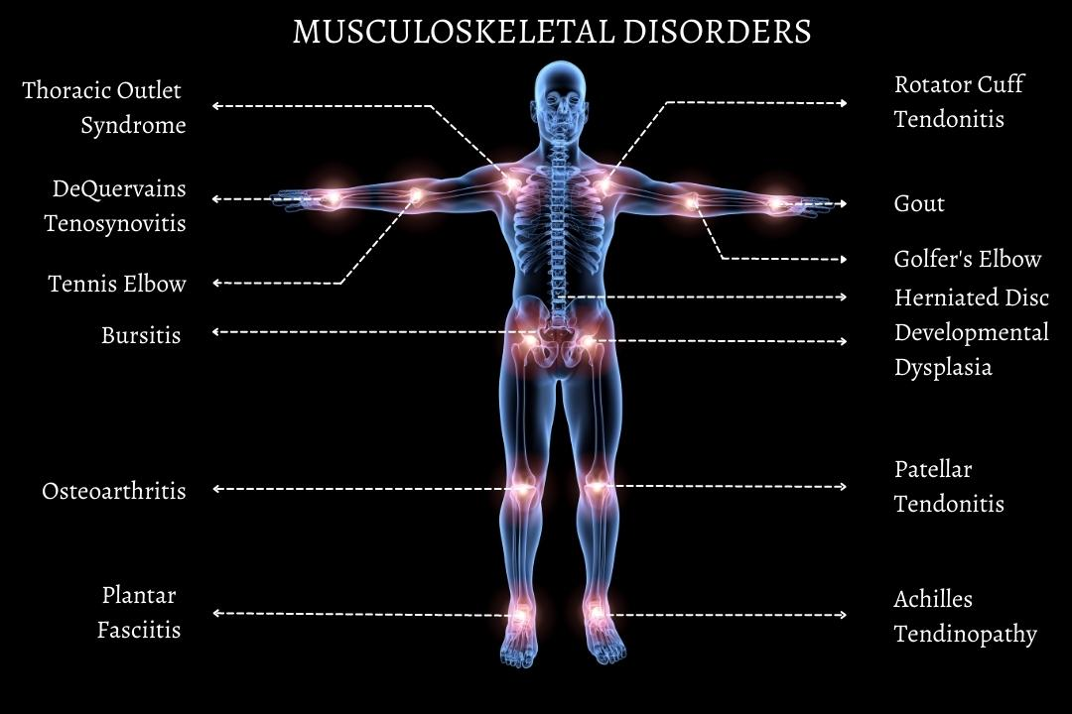
Musculoskeletal Disorders
This is an injury to the musculoskeletal system. It can involve muscles, bones, joints, tendons, ligaments, nerves, cartilage, and spine. It can be sudden injury or can develop over a long period of time. Most patient handling MSDs develop chronically and affect the back, neck, shoulders, and upper limbs.
Notes:
https://www.fgiguidelines.org/wp-content/uploads/2019/10/FGI-Patient-Handling-and-Mobility-Assessments_191008.pdf#

Slide 8
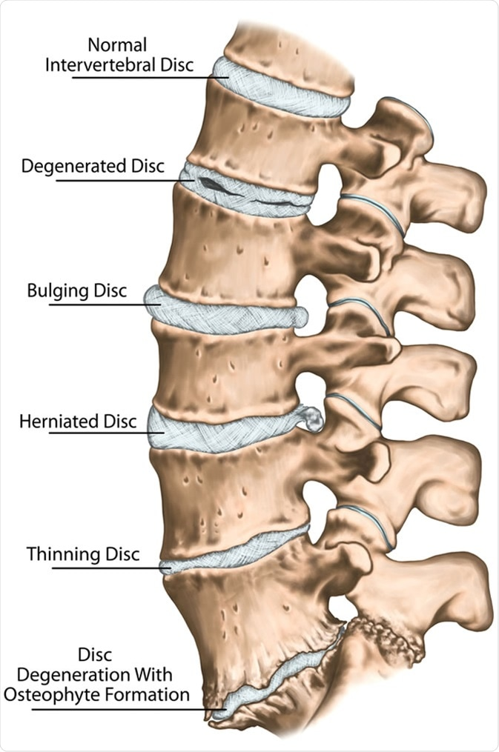
Cumulative trauma does not cause pain until sever injury has occurred
This image shows the course of cumulative microtrauma over a long period of time.
  How much pain do you think this individual's lower back feels at each of these stages?
    Possibly much less or much more than you expect.
    How would your back feel at each of these stages?
Notes:
Image: https://www.news-medical.net/image.axd?picture=2019%2F10%2F%40shutterstock_405564442.jpg

Slide 9
Your body and spine act as levers and fulcrums when lifting.
A fulcrum is that point on which a lever rests or is supported when it is used.
This allows you to lift with much more force than you could without such an advantage.
  This greatly increases the amount of weight being supported in different positions.
    For example: if your back is the lever and your waist is the fulcrum, the amount of weight on your low back is 10 times what it was!
      That does not even include your own weight (which you are also lifting).
      Bending, lifting, or other postures can make this weight burden even greater.
Notes:
https://www.iwu.edu/physical-plant/tailgate/no-month-handouts/back-safety.pdf
https://i.ytimg.com/vi/EsctLanQX8E/sddefault.jpg

Slide 10
With this in mind: How much force is really being applied to the low back of a healthcare worker?
The maximum amount of weight any healthcare worker should lift is less than 35 pounds.
  Turning is also included! When the fulcrum effect is considered, even a small person can be a serious risk.
  If a 150-pound caregiver turns a patient from side to side with a reach of 34-36 inches, he or she places the following stress on the lower back:
    100-pound (small) person: 1002 pounds
    150-pound (average) person: 1314 pounds
    200-pound (average) person: 1695 pounds
    250-pound (large) person: 2024 pounds

Slide 11
What are considered high risk patient care activities?
Transferring a patient
Lifting a patient
Weighing a patient
Repositioning a patient
Bathing a patient
Undressing/dressing a patient
Pulling up a patient in chair or bed
Feeding a patient
Putting ted-socks on patient
Providing care in awkward positions
Providing care in confined spaces.

Slide 12
What patient factors make patient handling high risk?
Patients are bulky, they have no carrying handles, and they cannot be held close to the body effectively.
Patients are delicate and prone to injury if dropped.
Patients are larger and more debilitated than they used to be.
Patients may be confused or may not know their own mobility status.
Patients are sicker than they used to be and more dependent on staff.
There is now an expectation for early mobility to reduce the risk of adverse events and decrease the length of stay.

Slide 13
What worker factors make patient handling high risk?
Awkward posture for long periods of time.
Co-worker assistance not predictable.
Many tasks require bent or twisted back.
Many lifting actions per shift cause fatigue and may exceed safe limits.
Aging of the workforce.
Inaccurate handoff communication.
Changes in working conditions over the last decades.

Slide 14
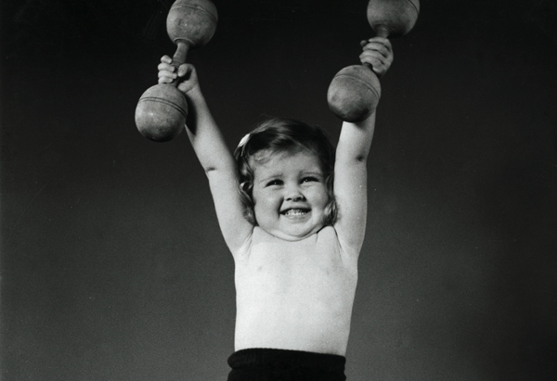
Health Care Workers are the ONLY Occupation that Believe 100 pounds is light!

Slide 15
Veterans cannot refuse SPHM equipment
Except in very specific circumstances, any patient can refuse any care offered to them. The patient cannot, however, demand that staff provide care in an unsafe manner. If a veteran attempts to do so this should be handled as follows:
  Carefully and thoroughly document the care refusal in a nursing note. Be sure to include all options offered to, and refused by, the veteran. If a solution is found, document it and pass on to following shifts.
  Discuss the issue with the veteran to try and figure out why he or she does not wish to use the SPHM equipment.
  Escalate the issue to your Unit Peer Leader or your unit management so they can find an alternative solution. If they are unable to do so, they will escalate the issue to the Safe Patient Handling and Mobility Facility Coordinator.
  If the veteran refuses all safe methods, escalate to management again. They will explain to the veteran that staff are not allowed to use handling and mobility methods that could endanger their own safety and/or that of the veteran. Unit management will also explain to the veteran that a safe method must be used (per policy) or care cannot be provided.

Slide 16

To whom can you direct questions?
Every unit has leaders who have extra training in SPHM equipment and technology. They are the Unit Peer Leaders (UPLs).
  The UPL helps with ergonomic assessments.
  The UPL signs off clinical skills competencies.
  The UPL provides education on SPHM issues when necessary.
  The UPL communicates needs to unit management and to the program manager.
  If you cannot locate a UPL, contact unit management with questions.
  If unit management cannot assist, contact the SPHM Program Manager.

Slide 17

Take the TIME
Use the Safe Patient Handling Equipment to
SAVE YOUR SPINE
REMEMBER: Do not lift more than 35 lbs. !

Slide 18


